Slide 1
Movie
Recommendation
System
Kushal Bhattarai
17031137

Slide 2
Introduction
Recommendation System are systems recommend certain products, services, or entities
Based on the problem of prediction or ranking of the products or entities
Types are Collaborative filtering, Content-based systems, and Hybrid systems.

Slide 3
Content Based recommendation
Suggests those objects that are alike in features.
Uses description of the content to suggest a recommendation
In the system, keywords, genre and overview and title are combined as features
recommendation are displayed with after finding similarity of the features.

Slide 4
Cosine similarity
The similarity between two vectors
Measured by the cosine of the angle between two vectors
Determines if the vectors are pointing in the same direction
Often used to measure document similarity in text analysis.

Slide 5
TF-IDF representation algorithm
Vector space representation
The system creates a content-based profile
based on a weighted vector of item features
The weights denote the importance of each feature to the user and can be computed from individually rated content vectors
Tfidfvectorizer was used in the system.

Slide 6
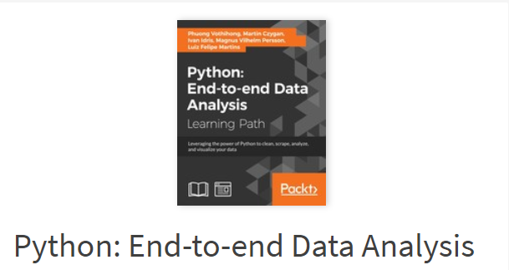
Research Work-1
Source:
https://learning.oreilly.com/library/view/python-end-to-end-data/9781788394697/
This book gave information about cosine similarity algorithm

Slide 7
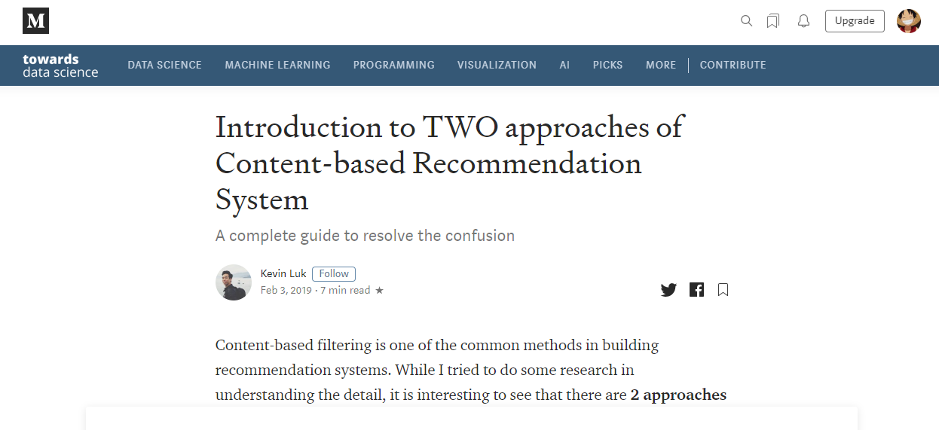
Research Work-2
Source:
https://towardsdatascience.com/introduction-to-two-approaches-of-content-based-recommendation-system-fc797460c18c
This website gave me a concept about the content based recommendation system.

Slide 8
Reason for selection
Recommendation system can be used in
E-commerce sites
movie streaming websites
learning management systems
health care
mobile and cloud-based applications.

Slide 9
Reason for selection
Helps the user choose correct decision in online transaction.
Doesn’t have cold start problem
The recommender system can determine the best recommendations for each user individually.
Recommend you the items based on features.

Slide 10
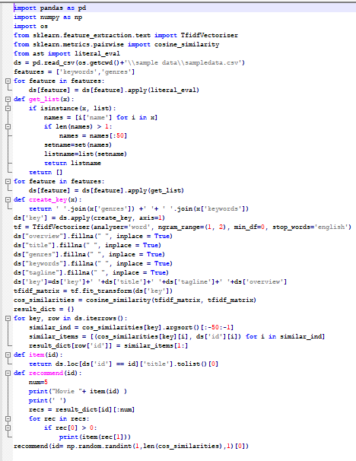
Solution of developed application

Slide 11
Solution of developed application

Slide 12
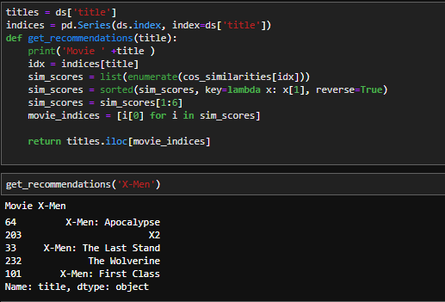
Additional code

Slide 13
Solution of developed application
Using panda and numpy libraries with sklearn libraries
Importing TfidVectorizer and cosine_similarity
Reading the data set using panda
Analysing the data
Preparing the data

Slide 14
Solution of developed application cont.
Finding cosine similarity
Finding similar items
Defining the recommend function with condition using id
Defining the recommendation function with condition using name
Calling the recommendation function for random movie using numpy.random using the id of the movie
Displaying upto 5 movies meeting the condition
Calling the recommendation function using movie name
Displaying upto 5 movies meeting the condition

Slide 15
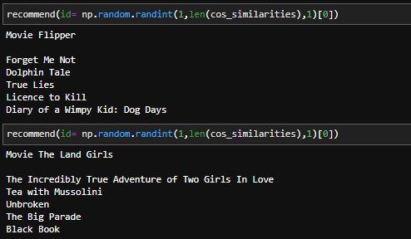
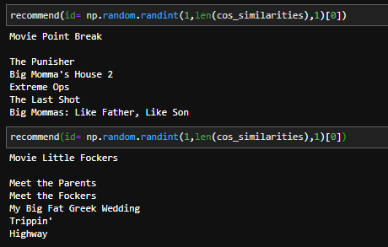
Results Achieved
Recommendation according to Movie id

Slide 16
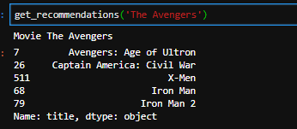
Recommendation according to Movie Name

Slide 17
How it solves real world problems?
The system can be used in E-commerce sites to recommend products during the opening days as data are not present and based on certain features of the product.
Using feature – feature similarity the products can be recommended.
It solves the cold start problem of other recommendation system

Slide 18
Pseudo code
Import packages
Import and StoreSampledata.csv
Preparing and correct data
Finding similarities of items
Finding recommendation
Displaying recommendations

Slide 19
Flowchart
Start
Input a movie title
Retrieve movie data
Remove stop words and words stemming
Extract and form keywords
Calculate similarity index
Compare similarity
Recommend similar movies
Display similar movies
End

Slide 20
THANK YOU

